Slide 1
CS5351 Software Engineering
2025/26 Semester A
Quiz 1

Slide 2
Summary
Bins | Num
100 | 2
85 | 0
80 | 8
75 | 11
70 | 13
65 | 23
60 | 74
47 | 40
32 | 16
Mean | Median | Max | Min
53.6 | 53 | 88 | 14

Slide 3
Summary
Inquiries and reviews regarding quiz scores will only be accepted within one week (Until Dec 1). No late request will be considered.
Questions | TA | Email
Q1, Q3 of S1 | Xiaona LI | xiaonali3-c@my.cityu.edu.hk
Q2, Q4 of S1 | Qilin ZHOU | qlzhou4-c@my.cityu.edu.hk
Q2, Q3, Q4 of S2 | Yue LI | yueli345-c@my.cityu.edu.hk
Q1, Q5 of S2, Q1 of S3 | Xiangrui ZENG | xiazeng9-c@my.cityu.edu.hk
Q2, Q3 of S3 | Zhuo WANG | zwang2346-c@my.cityu.edu.hk
Note: Q is short for Question, and S is short for Scenario.

Slide 4
Multiple-Choice Questions
Software Process
1. Which of the following is a missing element in a Scrum process that prevents tracking progress against a schedule?
A. Daily stand-up meetings
B. None of the other choices.
C. User stories
D. Code review
E. Release notes
Explanation: None of the other choices. E.g., the lack of burndown charts may prevent tracking progress against a schedule (see cs5351-process Pages 65-66).

Slide 5
Multiple-Choice Questions
2. In Scrum, what is the purpose of estimating story points for backlog items?
A. To assign tasks to developers
B. To determine the cost of development
C. To predict sprint velocity
D. To validate requirements
E. To prioritize bugs
Explanation: Estimating story points helps predict sprint velocity and plan deliverables.
(see cs5351-process.pptx Page 64)

Slide 6
Multiple-Choice Questions
3. Which metric is essential for forecasting project completion in Scrum?
A. Code coverage
B. Bug count
C. Project velocity
D. Team size
E. Release frequency
Explanation: Velocity measures the amount of work completed in a sprint and helps forecast project completion. (see cs5351-process.pptx Pages 64-66)

Slide 7
Multiple-Choice Questions
4. Why is tracking technical debt important in a Scrum project?
A. To reduce team size
B. To improve UI design
C. To ensure realistic project timelines
D. To increase code reuse
E. To automate testing
Explanation: Tracking technical debt ensures realistic timelines and helps prioritize refactoring tasks. (see cs5351-technica-debt-v5.pptx Page 7)

Slide 8
Multiple-Choice Questions
5. Which practice enforces the implementation of high-priority tasks in Scrum?
A. Sprint planning (e.g., determine which backlog item to be included in the sprint backlog)
B. Retrospective meetings (e.g., review of how to do better)
C. Daily stand-ups (e.g., report what will do and the obstacle)
D. Release management (e.g., manage the features to release at the end of a sprint)
Explanation: Sprint planning ensures high-priority tasks are selected for the current sprint. (see cs5351-process.pptx Page 68)

Slide 9
Multiple-Choice Questions
Software Requirements
6. Which of the following best describes a non-functional requirement?
A. The system shall allow users to log in
B. The system shall process payments
C. The system shall respond within 2 seconds
D. The system shall support user registration
E. The system shall generate reports
Explanation: Non-functional requirements describe system attributes like performance, not specific functions. (see cs5351-requirement-v8.pptx Pages 3-5)

Slide 10
Multiple-Choice Questions
7. What is the consequence of collecting but not implementing non-functional requirements?
A. The system will crash
B. The system may not meet business goals
C. The system will be faster
D. The system will be more secure
E. The system will be easier to maintain
Explanation: Non-functional requirements are critical to business constraints. Option A refers to functional failures, while options C, D, and E describe potential improvements. (see cs5351-requirement-v8.pptx Pages 3-5)

Slide 11
Multiple-Choice Questions
8. Which requirement engineering activity ensures requirements are feasible and correctly understood?
A. Specification
B. Negotiation
C. Validation
D. Elicitation
E. Prioritization
Explanation: Validation inspection of the requirement specification w.r.t. correctness, completeness, consistency, accuracy, and testability. (see cs5351-requirement-v8.pptx Page 43)

Slide 12
Multiple-Choice Questions
9. Which elicitation technique is most suitable under social relativism?
A. Interview
B. Observation
C. Prototyping
D. Document analysis
E. Facilitated workshop
Facilitated workshops are a group technique where multiple stakeholders discuss and negotiate requirements under the guidance of a facilitator. This directly addresses social relativism by enabling stakeholders from diverse backgrounds and perspectives to openly discuss, debate, and reach consensus, thereby managing social relativity.

Slide 13
Multiple-Choice Questions
10. Which process step is missing if only individual requirements are confirmed with skateholders?
A. Validation
B. Specification
C. Elicitation
D. Analysis
E. Negotiation
According to the requirements engineering process, if only individual requirements are confirmed with stakeholders while overlooking the overall coherence, conflicts, or priorities among requirements, then the missing step is E. Negotiation.

Slide 14
Multiple-Choice Questions
11. Which architectural view focuses on how software components are mapped to hardware in the 4+1 view software architecture for the Unified Process?
A. Use case view
B. Process view
C. Development vi
D. Logical view
E. Deployment view
In the 4+1 view software architecture, the Deployment view specifically focuses on how software components are mapped to hardware nodes.

Slide 15
Multiple-Choice Questions
12. What does the domain model in software architecture describe?
A. Code structure
B. Testing strategy
C. Database schema
D. Environmental constraints and significant architectural requirements
E. User interface layout
The core purpose of a domain model within a software architecture is to capture and describe the business domain of the problem being solved.

Slide 16
Multiple-Choice Questions
13. Which principle guides the selection of terminology in architectural documentation?
A. Encapsulation
B. Least privilege
C. User vocabulary alignment
D. Open-closed principle
Explanation: Using user vocabulary improves communication and understanding of architecture.

Slide 17
Multiple-Choice Questions
14. Which of the following is NOT considered technical debt?
A. Glue code for temporary database sync
B. Skipping unit tests for faster delivery
C. Feature backlog
D. Hardcoded configuration values
E. Outdated documentation
Explanation: Feature backlog is deferred work but not technical debt unless it increases future cost.

Slide 18
Multiple-Choice Questions
15. Which dimension of technical debt refers to whether the debt was created knowingly?
A. Type
B. Time horizon
C. Degree of focus
D. Intentionality
E. Severity
Explanation: Intentionality distinguishes between deliberate and inadvertent technical debt.

Slide 19
Multiple-Choice Questions
16. Which pattern contributes to technical debt due to unreasonable deadlines?
A. Duplication of code
B. Overengineering
C. Schedule pressure
D. Lack of documentation
E. Poor testing
Explanation: Schedule pressure forces teams to cut corners, leading to technical debt.

Slide 20
Multiple-Choice Questions
17. Which method is most effective for reducing technical debt?
A. Adding comments in code
B. Using bug tracking systems
C. Refactoring
D. Increasing test coverage
E. Writing documentation
Explanation: Refactoring is the only significantly effective way to reduce technical debt. (see cs5351-technical-debt-v5.pptx Page 12)

Slide 21
Multiple-Choice Questions
18. What is the impact of AI-generated code on technical debt?
A. Reduces code complexity to reduce technical debt
B. Improves delivery stability to reduce technical debt
C. Increases technical debt if unchecked
D. Eliminates the need for code review by human developers
E. Improves architectural soundness
Explanation: AI-generated code may introduce superficial fixes and increase technical debt without oversight. (see cs5351-technical-debt-v5.pptx Page 64)

Slide 22
Multiple-Choice Questions
Modern Code Review
19. What is the key purpose of modern code review that may be missed if alternative solutions are ignored?
A. Bug detection
B. Code improvement
C. Documentation
D. Security validation
E. Performance tuning
Explanation: Code improvement is a key goal of code review, which may be missed if better solutions are overlooked. (see cs5351-ModernCodeReview.pptx Pages 4)

Slide 23
Multiple-Choice Questions
20. Which of the following concerns raised during code review is most likely to result in breaking the regression test suite if not addressed properly?
A. Lack of inline comments
B. Use of deprecated API calls
C. Missing documentation for new modules
D. Unverified changes to shared utility functions
E. Inconsistent naming conventions
Explanation: Shared utility functions are often used across multiple modules. If changes to these functions are not properly verified or tested, they can introduce unintended side effects that break existing functionality—especially in regression tests designed to catch such issues. This is a common source of technical debt when review processes overlook the broader impact of localized changes. (see cs5351-ModernCodeReview.pptx Page 33)

Slide 24
Scenario 1: Fintech System Integration (29 marks)
A fintech company in Hong Kong is undertaking a major upgrade of its payment platform. The existing legacy payment system, which handles core transaction processing, must be integrated with a newly developed mobile payment subsystem that supports modern features such as QR code payments, instant notifications, and user analytics. The project team is divided into several subgroups: one responsible for legacy system maintenance (payment team), one for mobile subsystem development (mobile team), and one for integration, testing, and user experience (integration team).
The project manager has set the following goals:
Ensure iterative development and delivery to respond quickly to user requirements and feedback. User requirements on the mobile payment subsystem may change over time.
Integrate new features of the mobile payment subsystem incrementally with the legacy system through a series of releases of the implemented features provided by the mobile team, so that both old and new functionalities work seamlessly together through testing and validation during the integration phases.
Synchronize project details such as project knowledge, practice, coding standard, and code quality, across all three teams, especially during integration phases. The coordination among the teams should also be done during the integration phase.
Maintain high reliability and security throughout the upgrade.
The whole team must decide on appropriate software process models and development practices to achieve these goals.

Slide 25
Scenario 1 Q1(a):
(a) Based on Scenario 1, which software process models should the mobile team and the integration team adopt for this project, respectively. For each selected process model, provide the rationale by relating it to the characteristics of the project mentioned in the scenario.
[Marking Scheme]
Mobile team
1 mark for identifying Agile for developing the mobile payment system
1 mark for explaining why Agile is suitable for developing the mobile
Integration team
1 mark for identify incremental development
1 mark for its suitability for the integration with the legacy system

Slide 26
Scenario 1 Q1(a):
Mobile team is responsible for a newly developed mobile payment subsystem, it targets iterative development and delivery to respond quickly to user requirements and feedback, and user requirements on the mobile payment subsystem may change over time, so the mobile team should select Agile.
[Reference Answer]
Mobile team: Agile.
  for iterative development and responsiveness to user feedback.
  for incremental delivery for integration by sprint.

Slide 27
Scenario 1 Q1(a):
Integration team aims to integrate new features of the mobile payment subsystem incrementally with the legacy system through a series of releases of the implemented features provided by the mobile team, so the team should select incremental development.
[Reference Answer]
Integration team: Incremental development (or a software process model exhibiting this feature)
  for integrating each new increment delivered by the mobile team with the legacy system.
  to be responsive to user feedback and changes in requirements for the whole project.

Slide 28
Scenario 1 Q1(b):
(b) Moreover, also explain why the Waterfall model is unsuitable for the integration of the mobile payment subsystem and the legacy system.
[Marking Scheme]
Waterfall model
1 mark for explaining the Waterfall model not suitable for the integration

Slide 29
Scenario 1 Q1(b):
[Characteristics of Waterfall Model]
Requirements are assumed to be largely stable.
Analysis → design → implementation → testing is carried out once, in a strictly sequential manner from start to finish.
Integration is usually done until the later stages of the project, and it is difficult to make frequent changes at that point.
[Reference Answer]
Waterfall, V-Shape are not suitable for the integration with the legacy system as Agile requires incremental delivery, integration, and responsive to changes in requirements may occur. Spiral model is mainly for risk aversion, but the legacy system has been developed (so, not suitable).

Slide 30
Scenario 1 Q2: Marking Scheme
What are the main characteristics of modern code review (MCR)? Elaborate each of them. Design two MCR practices on top of the main MCR characteristics for the project in Scenario 1 so that the project can synchronize project details across the three teams. Give two examples of project details that can be benefited by the synchronization?
[8 marks in total] Characteristics -- 1 mark for each MCR main characteristics. -- 1 mark for the elaboration of each MCR main characteristics
[4 marks in total] Practices for synchronization -- 2 marks for each practice with cross-team feature
[2 marks in total] Example of synchronization/quality benefits -- 1 marks for each example

Slide 31
Scenario 1 Q2: Reference Answers
Main modern code review characteristics:
Informal. The process is lightweight and does not follow a strict, formal procedure. Reviewer roles are not predefined, and the review is often ad hoc.
Tool-based logistics. The review process is managed using tools such as GitHub, Gerrit, ReviewBoard, or even email and messaging apps. These tools facilitate asynchronous review and tracking of code changes.
Asynchronous. Authors and reviewers do not need to engage in the review at the same time. Reviews can happen independently, allowing flexibility for distributed teams.
Focused on reviewing code changes (patches). The review targets specific code changes (patches or pull requests), rather than the entire codebase. This makes the process more efficient and manageable.

Slide 32
Scenario 1 Q2: Reference Answers
Practices for synchronization across teams
Conduct code reviews regularly
Use cross-team reviewer assignments
can help synchronize project details to ensure
consistent code quality and coding standard,
facilitate knowledge and practice sharing,
educate developers or users
across the three teams.
Note: Reasonable answers can get the score. However, -- asynchronous (not occurring at the same time) -- synchronization (coordinating multiple processes to unite). They have opposite meanings.

Slide 33
Scenario 1 Q3:
In the context of Scenario 1, give one example task of each of the three process lifecycle activities (system analysis, design, and testing) that the integration team may perform so that it can integrate the new features delivered by the mobile team with the legacy system?
[Marking Scheme]
1 mark for describing a valid example of the system analysis task (still need to analyse what to integrate)
1 mark for describing a valid example of the design task (still need to design the integration such as developing the integration code and the protocol to make the two subsystems communicate well as well as the coordination with the two teams)
1 mark for describing a valid example of the validation/testing task (test not only the implementation of the integration code but also the integration of the whole system)

Slide 34
Scenario 1 Q3:
[Reference Answers]
The integration team should perform
  analysis (e.g., break down the deliverables of the mobile subsystem development team in each sprint/cycle into management),
  design (plan the integration of the that allow for testing and validation), and
  testing (validate the combined functionality, and coordinate with both legacy and mobile teams to ensure compatibility).

Slide 35
Scenario 1 Q3:
Moreover, for question Q1 in Scenario 1, you (student) should have selected a process model for the integration team. What is the constraint you will impose on the order of these lifecycles activities to deal with all releases by the mobile team throughout the project lifespan?
[Marking Scheme]
1 mark for mentioning phased integration over all increments provided by the mobile team.
[Reference Answers]
Since incremental development has been selected as the software process model, the integration team should ensure that the integration of the features delivered in each release delivered by the mobile team to the legacy system should be completed before the integration of the next release provided by the mobile team.

Slide 36
Scenario 1 Q4: Marking Scheme
The project manager aims to ensure rapid response to user feedback including changes in requirements and the feedback on implementation. What specific Agile practices should be implemented to achieve this? Also explain how each practice you provide help the project to achieve these two goals. Give three such practices.
1 mark for naming specific Agile practices (e.g., sprints, reviews, stand-ups, backlog), up to 3 practices.
1 mark for explaining how each practice helps with feedback and adaptation

Slide 37
Scenario 1 Q4: Reference Answers
Implement the following practices:
1. short development sprints; 2. regular sprint reviews and sprint meeting (e.g., daily stand-up meetings) to enable frequent feedback; 3. prioritize backlogs; 4. user participation in validating the completion of a backlog task to manage changing requirements; 5. put backlog tasks into sprint backlog.
These practices allow the team to 1. adjust plans quickly, 2. incorporate feedback, and 3. respond to changes in a timely manner.
Note: Reasonable answers can get the score. However, Extreme Programming, Scrum, and Hybrid Method are methodologies/frameworks, not specific agile practices. Only answering them is incorrect.

Slide 38
Scenario 2: E-Commerce Platform Requirements Engineering (27 marks)
A startup is building an e-commerce platform for local retailers in Hong Kong. The platform will allow customers to browse products, place orders, and make payments online. The client’s initial feedback is: “They should be fast.” However, stakeholders—including business owners, developers, and end users—disagree on the priority of security versus usability. Some want maximum security for payment and user data, while others prioritize a seamless, frictionless shopping experience. You are aware of the tradeoff of quality attribute and know that security and usability are a pair of conflicting quality attributes.
Requirements are being gathered from multiple sources: interviews with business owners, surveys of potential customers, and analysis of competitor platforms. The requirements documentation is currently written in natural language and contains ambiguities such as “the system should be scalable” and “the checkout process should be simple.”
The project manager wants to:
Identify and clarify both functional and non-functional requirements.
Resolve conflicts between stakeholders regarding priorities.
Ensure requirements are measurable, testable, and unambiguous.
Select appropriate elicitation and prioritization techniques to guide the development process.

Slide 39
Scenario 2 Q1: (2 marks)
Q1. From the client’s feedback (“They should be fast”), identify one functional and one non-functional requirement for the e-commerce platform.
Marking: 2 marks
1 mark for a correct functional requirement
1 mark for a correct non-functional requirement

Slide 40
Answers:
Functional: The system allows customers to browse and purchase products online.
Non-functional: The browsing and purchase of products should be fast.

Slide 41
Scenario 2 Q2 (12 marks)
Q2. The requirements documentation contains ambiguous statements such as “the system should be scalable” and “the checkout process should be simple.”
As a requirement analyst, you plan to conduct an interview session with the users to get a clearer requirement with the rationale and consequence of including or not including the requirements into the project for implementation.
a) Even you have decided to interview users, you know that there are four other process steps before this elicitation step in requirement engineering process. What are they?
b) For the interview, you want to standardize the requirement template across all requirements, do you have any suggestion that fits the above goal?
c) After the interview, you want to confirm with users about your understanding on the collected requirements. Which process activity in the requirement engineering process you will perform?
d) What is the strategy to use to get a more reliable requirement when confirming it with users?

Slide 42
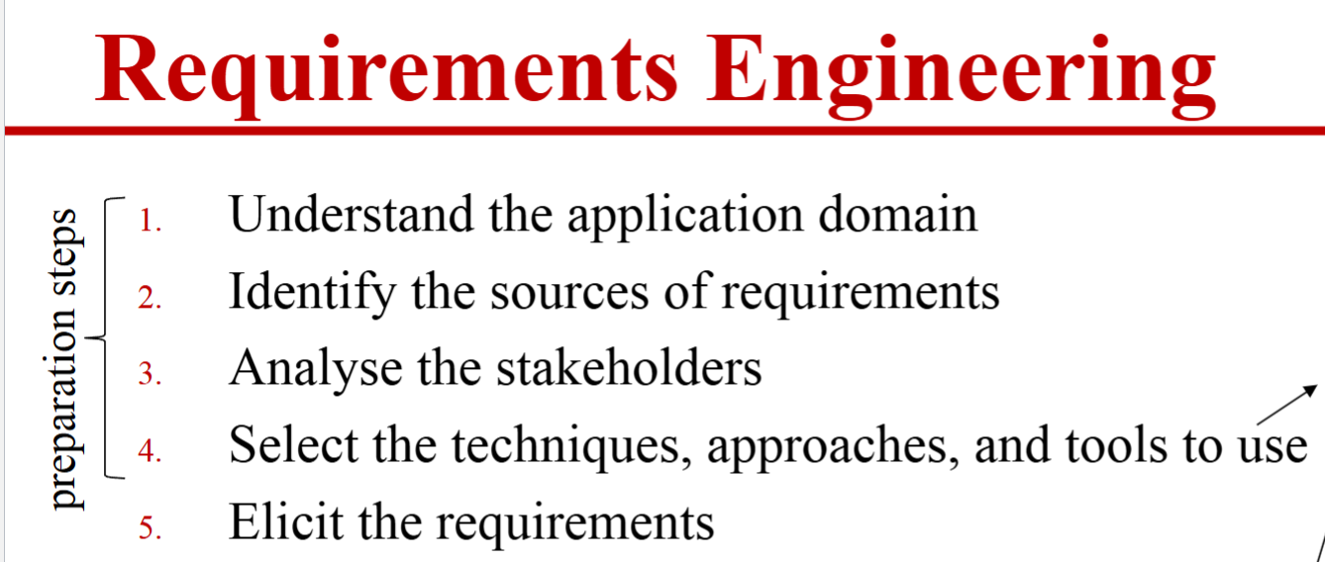
Scenario 2 Q2 a) (8 marks)
a) Even you have decided to interview users, you know that there are four other process steps before this elicitation step in requirement engineering process. What are they?
Marking: 8 marks, 2 marks for each step.
Reference Answers: Understanding the application domain, Identifying the sources of requirements, Analyzing the stakeholders, Selecting the techniques, approaches, and tools to use. (Tutorial: Requirement Elicitation.pptx P2)
Incorrect Answers:
Four major steps in an RE process
1. understanding the problem: elicitation
2. describing the problem: specification
3. agreeing upon the nature of the problem: validation
4. agreeing upon the boundaries of the problem: negotiation

Slide 43
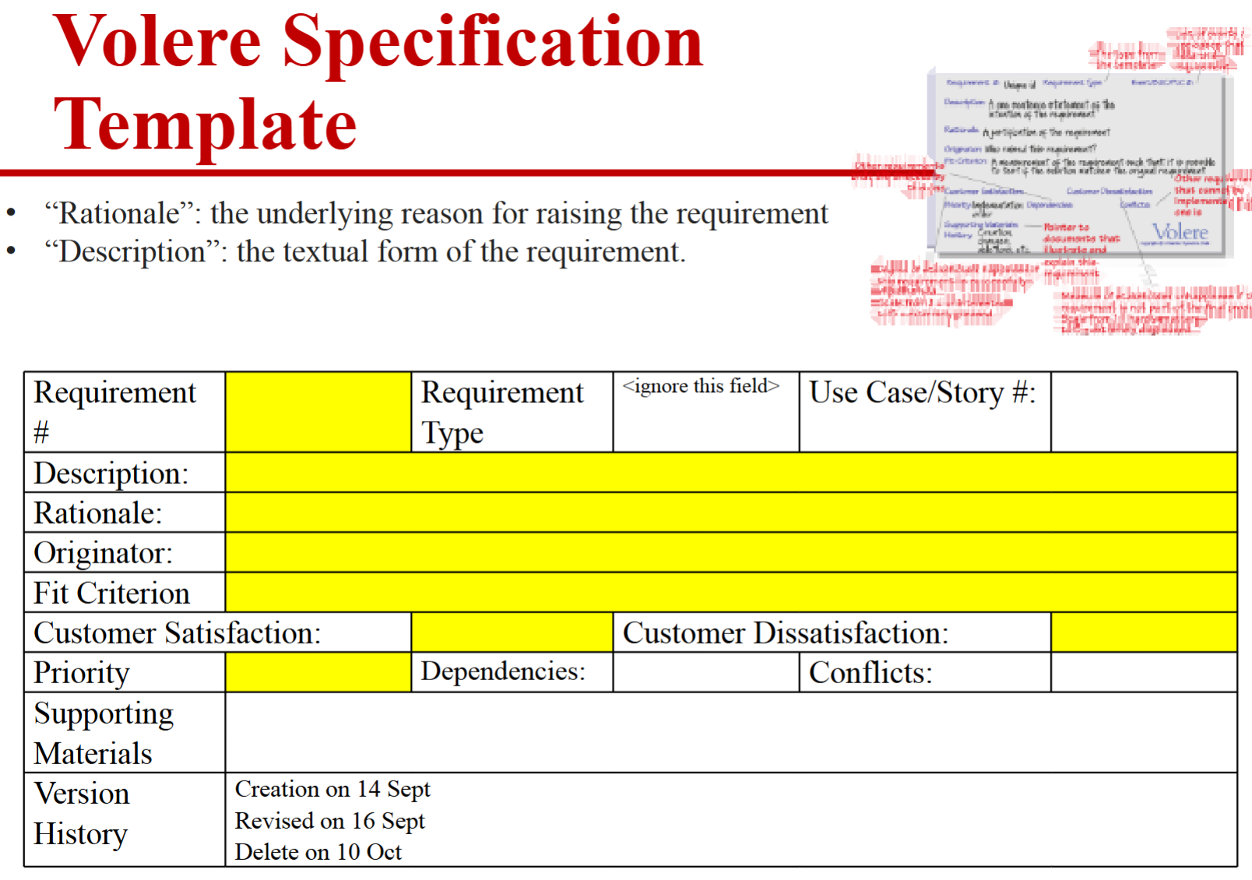
Scenario 2 Q2 b) (1 mark)
b) For the interview, you want to standardize the requirement template across all requirements, do you have any suggestion that fits the above goal?
Marking: 1 mark.
Reference Answers: Volare/Volere card.
(Tutorial: Requirement Elicitation.pptx P3)

Slide 44
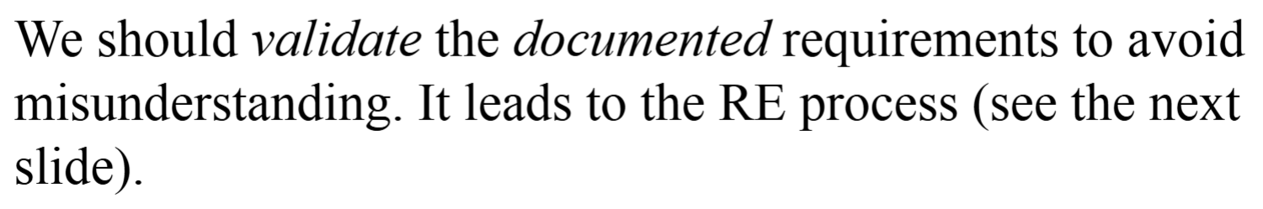
Scenario 2 Q2 c) (2 marks)
c) After the interview, you want to confirm with users about your understanding on the collected requirements. Which process activity in the requirement engineering process you will perform?
Marking: 2 marks.
Reference Answers: Validation.
([Week 3] Software Requirements.pptx P12)
Incorrect Answers:
Negotiation: to resolve ambiguity due to stakeholders with different goals (e.g., workers against management).

Slide 45
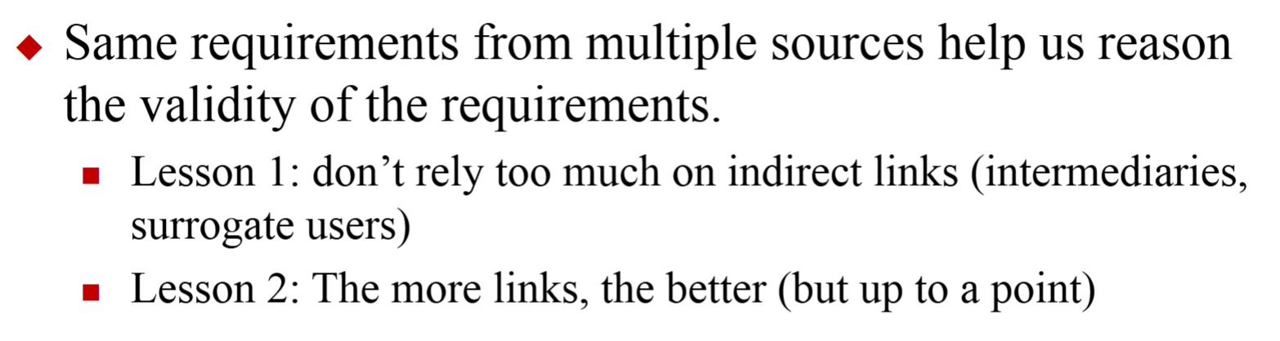
Scenario 2 Q2 d) (1 mark)
d) What is the strategy to use to get a more reliable requirement when confirming it with users?
Marking: 1 mark.
Reference Answers: Confirming the requirement with a small number of sources for consistency.
([Week 3] Software Requirements.pptx P42)
Incorrect Answers:
Inspection of the requirement specification w.r.t. correctness, completeness, consistency, accuracy, readability, and testability. ([Week 3] Software Requirements.pptx P43)

Slide 46
Scenario 2 Q3 (4 marks)
Q3. Stakeholders disagree on the priority of security versus usability. You understand that you can take different requirements analyst positions. Which position should be better be adopted to address this conflict, and which elicitation technique is most suitable? Explain briefly why the position you will take is suitable and the technique to be used.
Marking: 4 marks. 1 mark for correct analyst position, 1 mark for brief justification for the position, 1 mark for the selected technique, 1 mark for suitable technique and brief explanation.
Reference Answers:
Adopt one of the following positions:
radical-structuralism (objective + conflict) to address conflicting stakeholder goals. Radical-structuralism is suitable for clear, fundamental conflicts.
Social-relativism (subjective + order): If the goal is to build consensus through collaboration andnegotiation, especially when stakeholders have different perceptions but are open to compromise.Social-relativism is suitable for consensus-building.
For this Scenario 2, (subjective + order) is a better choice.

Slide 47
Scenario 2 Q3 (4 marks)
Technique:
Use a facilitated workshop or negotiation session to collaboratively prioritize requirements and resolve conflicts.
([Week 3] Software Requirements.pptx P16 & P35)
Incorrect Answers:
Focus group

Slide 48
Scenario 2 Q4 (4 marks)
Q4. The project manager wants requirements to be measurable and testable. Rewrite the ambiguous requirement “the system should be scalable in processing payment” into a measurable and testable requirement suitable for the e-commerce platform scenario such as the HKTV mall platform for the Hong Kong market.
Marking: 4 marks. 2 marks for quantifying scalability (e.g., number of users, response time), 2 marks for making it testable (clear criteria for testing).
Reference Answers:
“The system must support at least 5,000 concurrent users during peak shopping hours with a response time of less than 2 seconds for 95% of payment transactions.”

Slide 49
Scenario 2 Q5 (5 marks)
Q5. Suppose the team is analysing competitors’ e-commerce platforms. All platforms are found to consider security as an important feature. But the team also finds that some have complex checkout processes while others are streamlined but less secure. There are also features of personalized recommendation about the screens and action buttons in the checkout processes on some platforms. One competitor platform adds a 15-second game as a feature after the checkout button is pressed to enhance the user experience.
The project team selects the MoSCoW method as the requirements prioritization approach. Extract the platform features mentioned above and prioritize them according to the requirement categories in the MoSCoW method. Explain the order of your priority to resolve conflicts.

Slide 50
Scenario 2 Q5 (5 marks)
Answers:
Use the MoSCoW method to classify requirements as
Must (e.g., secure payment processing),
Should (e.g., streamlined checkout),
Could (e.g., personalized recommendations),
Won’t have (e.g., features that add unnecessary complexity).
From the survey, all consider security, and while usability could be lowered, but there are strategies (such as adding games or personalization) to improve the usability.
Marking: 5 marks
1 mark for each correct identification of the features in each of the four requirement categories in MoSCoW
1 mark to state usability improvement by multiple means

Slide 51
Scenario 3: Startup Technical Debt Management
(24 marks)
A software startup in Hong Kong has developed a Software-as-a-Service (SaaS) platform for logistics and supply chain optimization. The team has rapidly added new features in response to customer requests, integrated AI-assisted code generation, and frequently changed requirements. As a result, bug fixes are taking longer, new features are harder to implement, and the system’s reliability is declining (e.g., more incidences of system failures to complete a function).
The CTO suspects that technical debt is accumulating in several dimensions: design shortcuts, insufficient testing, outdated documentation, no documentation on requirements and design, and inconsistent code quality. The team uses modern code review tools, but refactoring tasks are often postponed or skipped due to tight deadlines. The CTO also reviews the project task board of the SaaS project, yet there is no sign of technical debt backlog. The project manager also says that there is currently no plan to track technical debts, since all requests and bug fixing must be handled immediately to keep the business up and running.
The company wants to:
Identify and classify the technical debt present in the system.
Monitor and resolve technical debt without disrupting ongoing feature development.
Use code review and automation to manage debt introduced by AI-generated code.
Develop a strategy to maintain delivery stability and system reliability as the platform grows.

Slide 52
Scenario 3 Q1: (14 marks)
Q1. There are four dimensions for technical debts. Extract the examples from Scenario 4 for each dimension and explain which kind of debt each example refers to in that dimension.
Note that not all categories in all four dimensions may have examples mentioned in the scenario.
Marking: 14 marks
4 marks: 1 mark for each dimension name
4 marks for Type
  1 mark for each example
2 marks for Intentionality
  1 mark for each example
2 marks for Time horizon
  1 mark for each example
2 marks for Degree of focus
  1 mark for each example

Slide 53
Scenario 3 Q1: (ReferenceAnswers)
Q1. There are four dimensions for technical debts. Extract the examples from Scenario 4 for each dimension and explain which kind of debt each example refers to in that dimension.
Note that not all categories in all four dimensions may have examples mentioned in the scenario.
Answers:
Type: Design shortcuts, insufficient testing, outdated or missing documentation, and inconsistent code quality.
Intentionality: Some debt is intentional (e.g., shortcuts for deadlines), some is unintentional (e.g., issues from AI-generated code).
Time horizon: short-term (quick fixes due to reactive to fast delivery). No long term (no debt example in the scenario is generated proactively)
Degree of focus: Debt are unfocused since they are not managed (tracked) systematically (no plan to track technical debt and refactoring is often postponed/skipped).

Slide 54
Scenario 3 Q2(Afternoon): Marking Scheme
Q2. Propose one method to monitor technical debt in this scenario
without disrupting ongoing feature development and one method to resolve
it. You can assume that the project uses an Agile development process.
[4 marks in total]
Monitoring method [2 marks]
Resolution method [2 marks]

Slide 55
Scenario 3 Q2(Afternoon): Reference Answers
Q2. Propose one method to monitor technical debt in this scenario
without disrupting ongoing feature development and one method to resolve
it. You can assume that the project uses an Agile development process.
Monitor technical debt using a task board (Kanban board) or product backlog to track refactoring tasks. (see cs5351-technical-debt-v5.pptx Pages 42-44)
Resolve debt by scheduling regular refactoring sessions and prioritizing critical areas for improvement, possibly integrating debt repayment into sprint planning. (see cs5351-technical-debt-v5.pptx Page 46)

Slide 56
Scenario 3 Q3(Afternoon): Marking Scheme
Q3. Describe how modern code review and automation tools (like
automated testing or automated static code analysis tools) can help manage
technical debt introduced by AI-generated code.
[4 marks in total]
Code review benefits [2 marks]
Automation benefits [2 marks]

Slide 57
Scenario 3 Q3(Afternoon): Reference Answers
Q3. Describe how modern code review and automation tools (like
automated testing or automated static code analysis tools) can help manage
technical debt introduced by AI-generated code.
Modern code review enables early detection of code quality issues and ensures adherence to standards.
Automation (e.g., static analysis tools, automated testing) can identify and report problematic patterns in AI-generated code, helping reviewers to identify technical debts.

Slide 58
Scenario 3 Q4(Afternoon):
Multiple Answer
Q4. Which of the following is NOT an effective method for tracking technical debt in a software project in the scenario?
[2 marks in total]
A. Using a product backlog
B. Adding comments in code
C. Using review meetings
D. Maintaining a Kanban board
Explanation: Options A and C can visualize the technical debts. (see cs5351-technical-debt-v5.pptx Pages 42-44)

Slide 59
Scenario 3 Q2(Evening): Marking Scheme
Q2.A team member suggests applying a large language model (LLM) to
review the code to generate the technical debts and post them on the task
board. For each of the four dimensions of technical debt, explain with an
example to illustrate why the LLM cannot help to distinguish a technical
debt in that dimension.
[10 marks in total]
Type [3 marks]
Intentionality [2 marks]
Time horizon [2 marks]
Degree of focus [3 marks]

Slide 60
Scenario 3 Q2(Evening): Reference Answers
Type [3 marks]:
  Design shortcuts (because no design rationale is documented)
  Insufficient testing (no testing outcome for judgment)
  Outdated documentation
Intentionality [2 marks]:
  LLM cannot determine the nature of intentionality of the current code from the code itself (intended technical debt also requires a knowledge of the debt consequence and how to address them, which is unavailable in the code itself).
Time horizon [2 marks]:
  For short-term code debt (quick fixes due to reactive to fast delivery) can be identified by LLM, but not long-term code debt.
  The time horizon for non-code debt cannot identified.
Degree of focus [3 marks]:
  The degree of focus (regardless of focused or unfocused) cannot be determined because the method to manage debts could not be appeared in the code.

